Slide 1
HOW TO WORK ATM MACHINE

Slide 2
INTRODUCTION
FEATURES: CHECK BALANCE
WITHDRAW MONEY
DOPOSIT MONEY

Slide 3
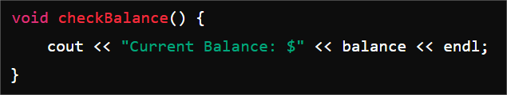
CODE STRUCTURE
Global Variable: stores the current balance
GLOBAL VARIABLE :A variable that can be used or accessed from anywhere in the entire program
BALANCE

Slide 4
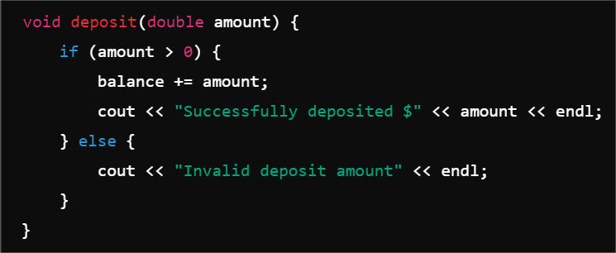
FUNCTION
THIS FUNCTION ADDS MONEY TO THE BALANCE . IF CHECKS IF THE DOPOSIT
AMOUNT IS GREATER THAN 0 IF YES IT ADDS THE AMOUNT TO
AND PRINT A SUCCES MESSAGE
G ADDS THE DEPOSIT AMOUNT TO THE BALANCE
E IF THE AMOUNT IS NOT GREATER THAN ZERO IT PRINTS INVALID
BALANCE
BALANCE +=AMOUNT
ELSE

Slide 5
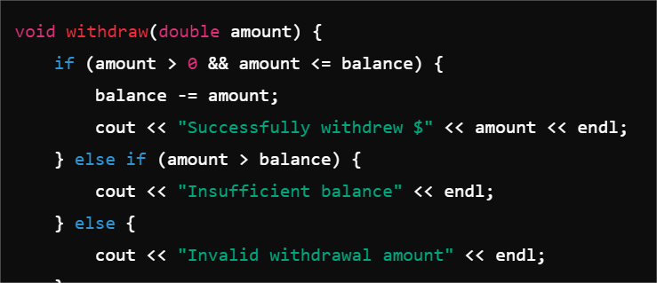
WITHDRAW FUNCTION
CHECKS IF THE WITHDRAW AMOUNT IS POSITIVE AND LESS THAN OR EQUAL TO THE CURRENT BALANCE
SUBTRACTS WITH WITHDRAWAL AMOUNT FROM THE
BALANCE
IF AMOUNT >0 &&AMOUNT <=BALANCE
BALANCE - =AMOUNT

Slide 6
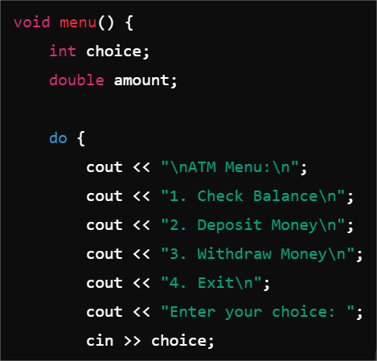
ATM MENU
DISPLAY OPTIONS
TAKES USER INPUT FOR DIFFERENT FUNCTIONS

Slide 7
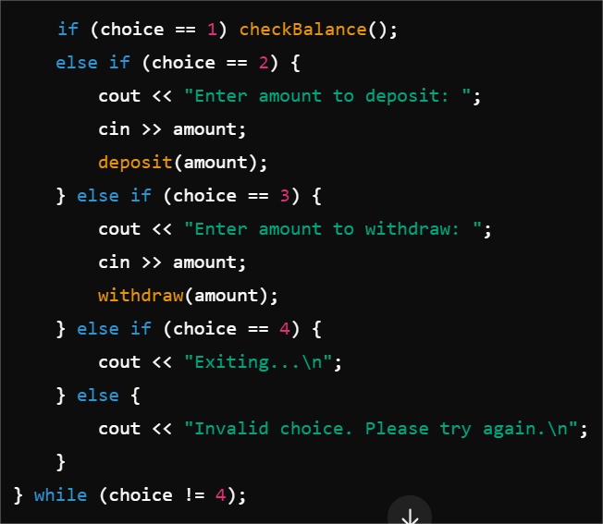
MENU EXECUTION
J

Slide 8
Checks if the user chose option 1
If yes, it calls the function to display the current balance
If the user chose option 2, it means they want to deposit money
The program asks the user to enter the deposit amount
using
The user inputs a number, which gets stored in
Calls the function to add the money to the
BALANCE
CHECK BALANCE
COUT
AMOUNT AND CIN
DEPOSIT AMOUNT

Slide 9
If the user chose option 3, it means they want to withdraw money.
The program asks the user to enter the withdrawal amount.
The user inputs a number, which gets stored in
Calls the function to deposit the money
from the balance (if there’s enough).
If the user chose option 4, it means they want to exit the
ATM program.
The program prints "Exiting..." to let the user know the program is CLOSING.
AMOUNT
WITHDRAW AMOUNT

Slide 10
If the user enters a number that is not 1, 2, 3, or 4, this error message appears.
The program tells the user that their input is invalid and asks them to try again.
The loop keeps running until the user enters 4 (Exit option).
As long as the menu keeps displaying and accepting user input again.
CHOICE ! = 4

